Slide 1
Use Your Strengths
Grow your worth
Notes:
Instructor:
Read through the whole lesson (including all the notes) before the day of class
Make note of and gather any supplies you need to bring
Prepare examples, stories
Think through how much time you want to spend on individual activities; make notes
Be sure to allow time to announce the assignment at the end
Overview:
Intro (slides 1-3): 3-5 minutes
Strengths (slides 4-32): 35-45 minutes
Conclusion (33-36): 2-3 minutes
Total: 40-53 minutes

Slide 2
Review
How was your experience this week with:
Identifying “the Smart Guy Problem”?
Identifying BS?
Practicing active listening?
Notes:
Ask: What did we go over last week?
Homework will be self-graded in-class based on completion and effort

Slide 3
Today
Objectives:
Discuss strengths and develop the desire to use them.
Why are our strengths important?
How can knowing our strengths benefit us?
How do our strengths affect others?

Slide 4
Strengths
Notes:
Intro (slides 1-3): 3-5 minutes
Strengths (slides 4-32): 35-45 minutes
Conclusion (33-36): 2-3 minutes
Total: 40-53 minutes

Slide 5
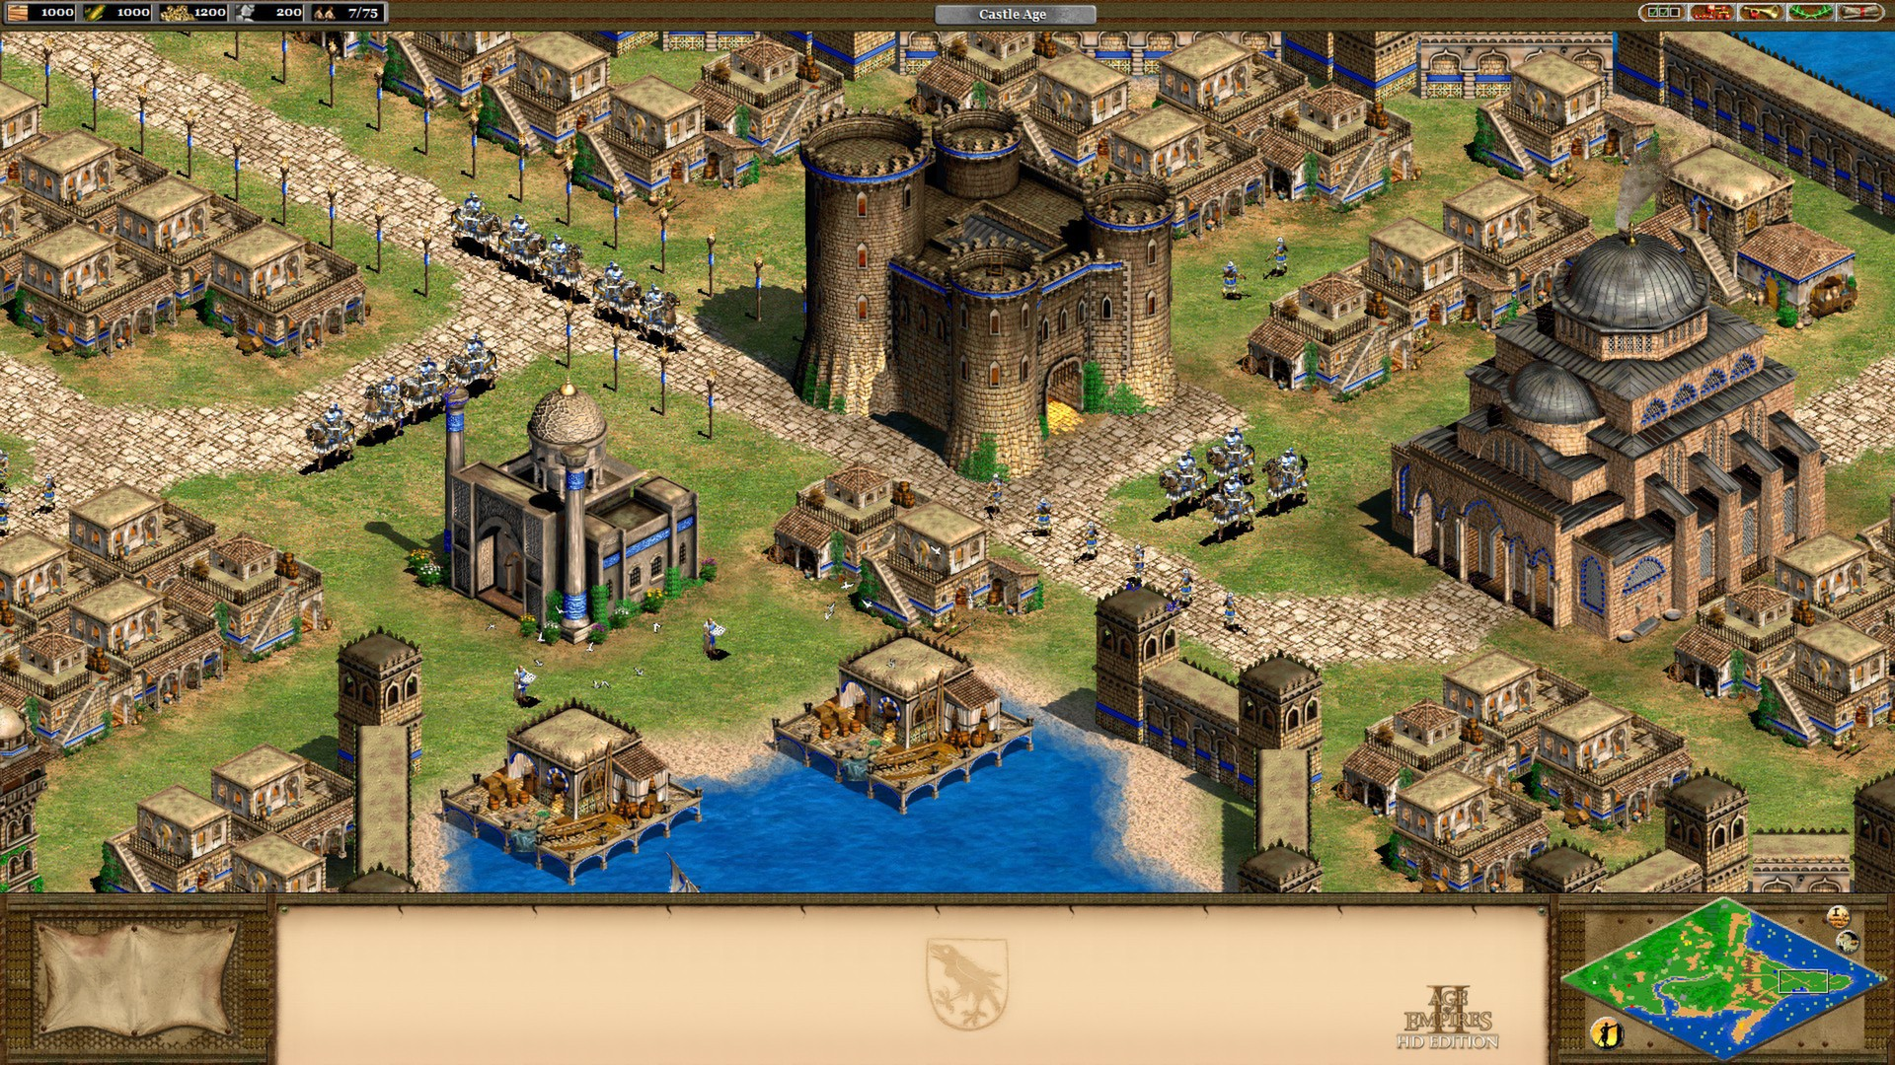
Name this game?
Notes:
Source: https://www.ageofempires.com/wp-content/uploads/2015/07/3.jpg

Slide 6
Who in this room HASN’T played Age of Empires (preferably II)?
Bottom line: You probably should. Today, if you can.*
Let’s go over a few terms from A of E
* WARNING: Age of Empires, like other addictive games, may cause harmful effects to your grades and relationships. Please play responsibly.

Slide 7
“Countering”
Is anyone familiar with this term, as it relates to Age of Empires?
Countering: each unit in the game is effective against another specific unit; use a given unit to counter another.
Notes:
Examples on next page

Slide 8
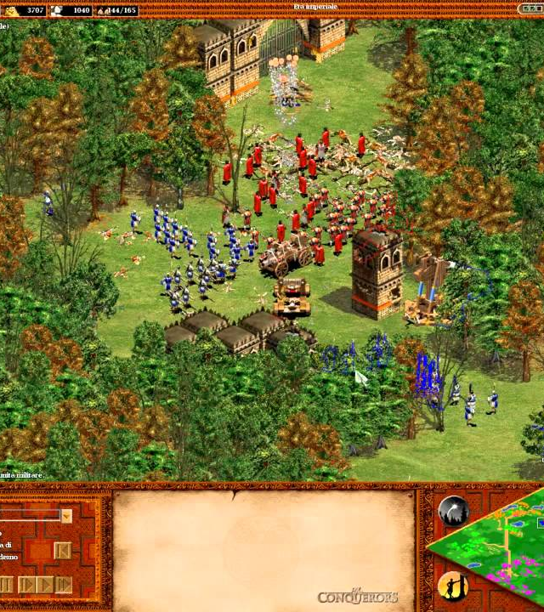
Countering
Archers (at range) > Infantry
Pikemen > Cavalry
Fire ship > Galleon
Cavalry > Archers
Etc.
Notes:
Image from youtube.com

Slide 9
“Spamming”
Spamming: Making a bunch of one unit and hurling them at the enemy
One way to do it:
Encircle the enemy’s base with barracks
Set the gather point for in their base
Make lots of cheap units
Spam, spam, spam…
How does this nerdy term relate to Age of Empires?

Slide 10

Notes:
https://www.youtube.com/watch?v=VB7ZpUUqd7g
(Watch until you get the point—sorry about the music.)

Slide 11
Reflect
What happened?
Was it what you expected?

Slide 12
Take-aways
Even if you have an awesome unit (e.g., War Elephants), they’re not guaranteed to win if you don’t use them effectively
Knowing the strengths of each unit will enable you to be more successful in the game

Slide 13
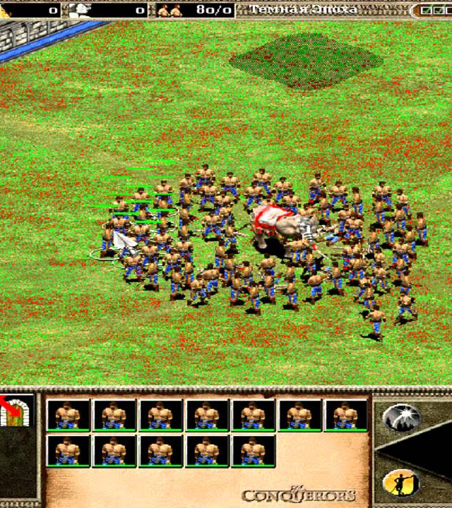
A of E + Strengths
Each unit in Age of Empires has a specific use, and a specific ability, talent, or predispositions (strength)
Obviously, they also have drawbacks – but we’re going to focus on what they do well
Notes:
Image from youtube.com

Slide 14
Case Studies
Let’s go through a few case studies to give some more life to this idea

Slide 15
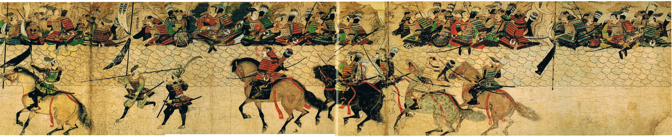
Case Study: Genghis Khan
The cavalry archers (Mangudai) you saw in the YouTube video are based on the actual soldiers in Genghis Khan’s army. The Mongols were expert horsemen, and used their horses to outmaneuver their enemies.
Khan employed “Parthian tactics” (named after the ancient Iranian empire) on the battlefield, where a mounted archer, retreating from combat, would turn around on his horse and fire arrows at pursuers. This strategy was mastered by the Mongols and was instrumental in their establishment of the largest contiguous empire in history.
Notes:
Sources:
https://en.wikipedia.org/wiki/Genghis_Khan
https://en.wikipedia.org/wiki/Parthian_shot

Slide 16
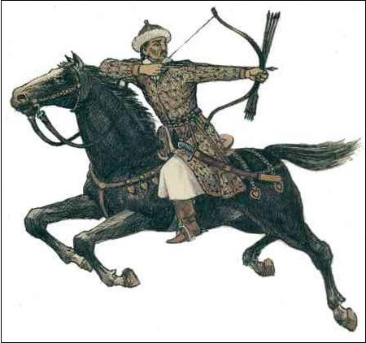
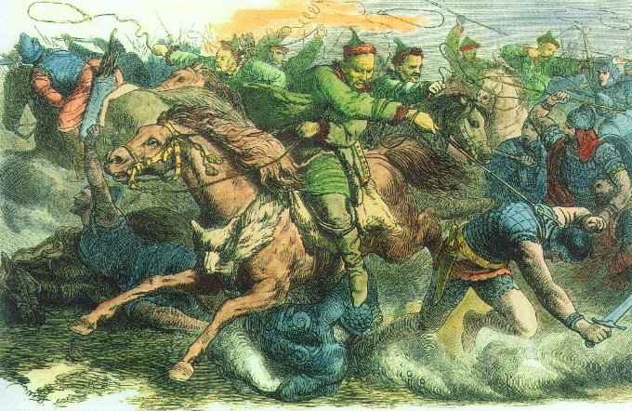
Case Study: Genghis Khan
Other armies tried to replicate the success of this tactic, but could not reach Khan’s army in their mastery of their horses, or their marksmanship.
Khan’s armies had a unique advantage over their foes, based on their unique strengths.
Notes:
Images from Wikipedia.org, www.twcenter.net

Slide 17
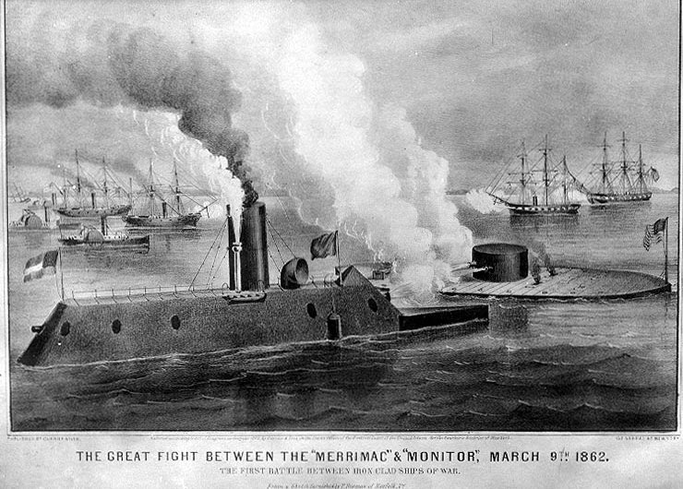
Case Study: the Ironclad
Notes:
Image from www.americancivilwar.com

Slide 18
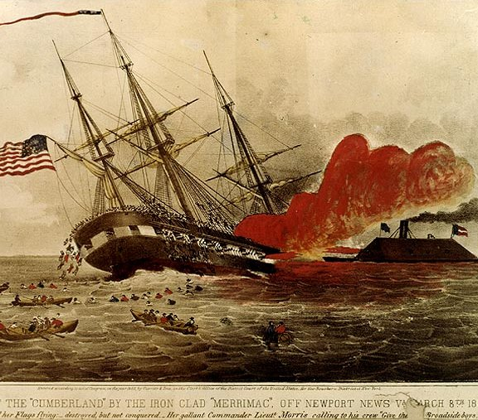
Case Study: the Ironclad
Another example of innovation-led military dominance was the Ironclad, built in the mid-1800s.
Cannonballs tore into the hull and crew of revolutionary-age frigates. To avoid this, naval designers built a vessel which had sloped sides made of hard metal. This deterred cannonball fire, making it almost impossible for the frigates to defeat.
Notes:
Source: https://en.wikipedia.org/wiki/Ironclad_warship
Image from www.americancivilwar.com

Slide 19
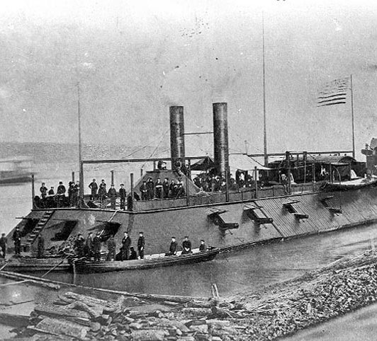
Case Study: the Ironclad
Just as Genghis Khan had dominated the battlefield, the ironclad dominated the water in the mid 1800s.
Yes, it later became obsolete, but for a time it was the leading innovation in naval warfare
Notes:
Source:

Slide 20


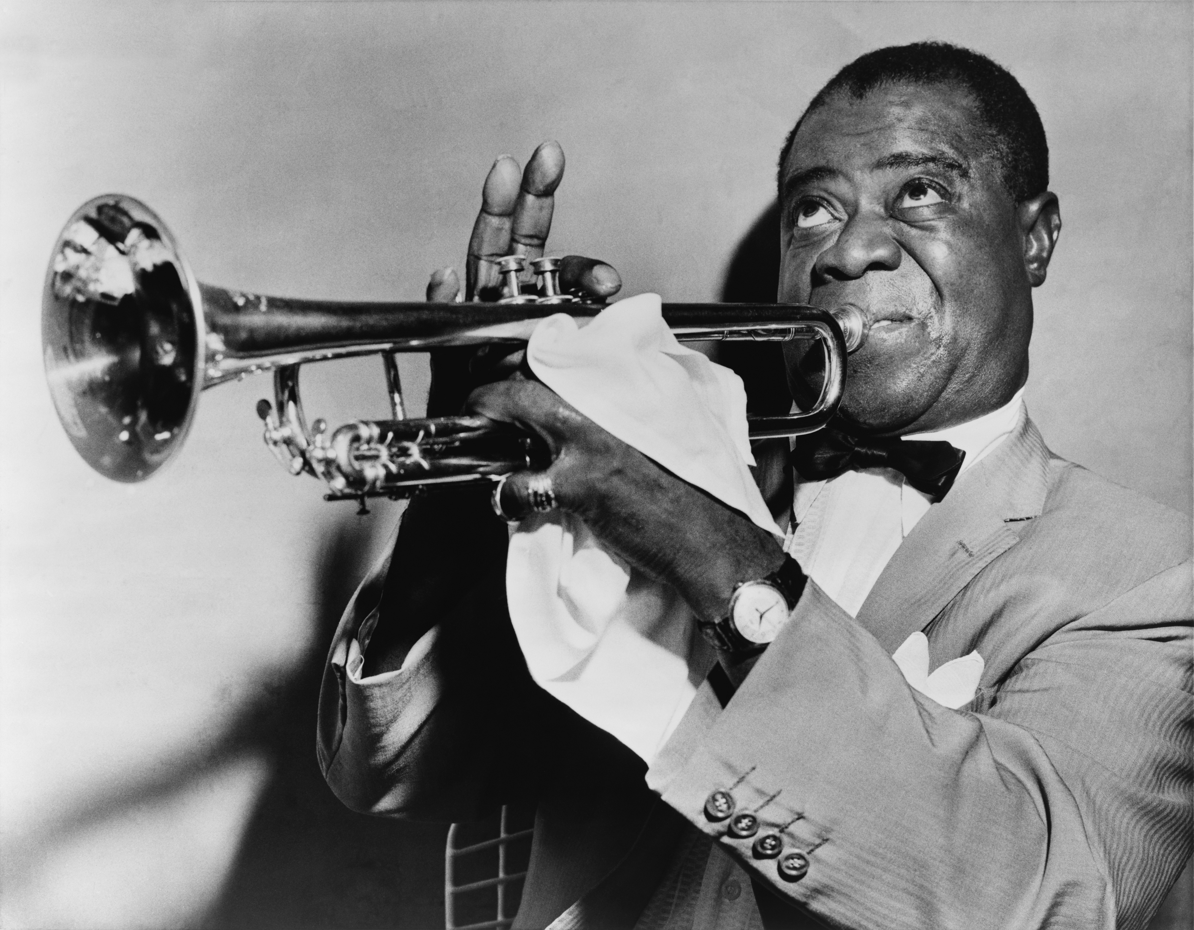

Reflect & Discuss
What personal strengths do you admire most?
Think of people who exhibit those strengths.
What effect have your heroes had on the world?
Notes:
Pictured: Wayne Gretzky, Malala, Louis Armstrong, Angela Merkel
Images from en.wikipedia.org, www.jugantor.com

Slide 21
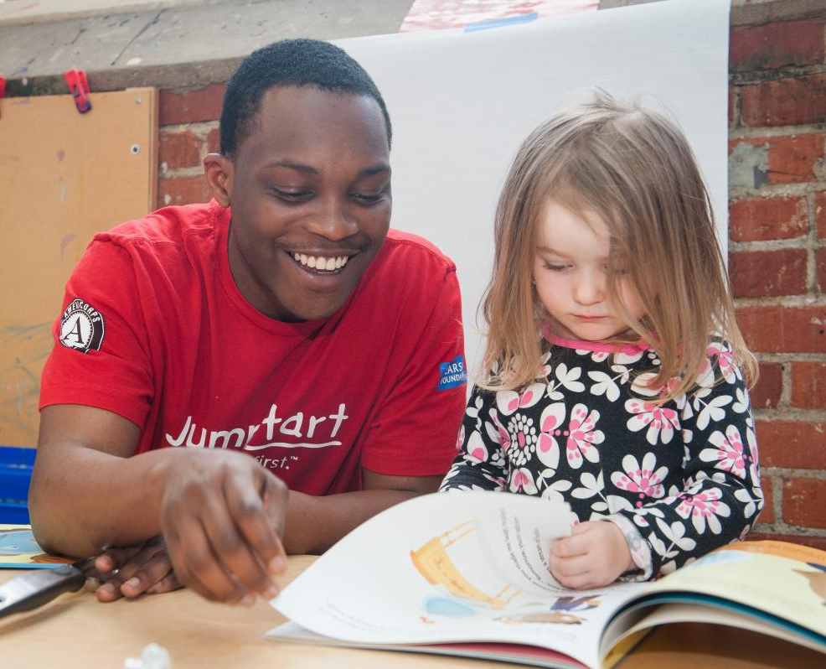
Strengths
Strengths—and the people with them—really do change the world!
Skills can be taught, but typically the strengths that change the world are innate talents that people work to develop.
Notes:
Image from www.imls.gov

Slide 22
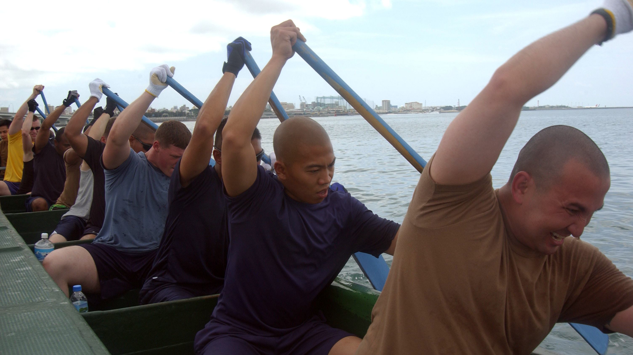
Strengths
Knowing our strengths and others’ boosts
+ Purpose
+ Efficiency
+ Morale

Slide 23

Strengths
Like we mentioned before, there are entire companies that focus on identifying your strengths so that you can utilize them.
A few examples:
Gallup StrengthsFinder test (2.0)
Signature Strengths test (Martin Seligman, positive psychologist)
Notes:
Image from strictly-business.com

Slide 24
Note
Taking these tests is HIGHLY recommended, but not required for this course
They are potentially life-changing—seriously!

Slide 25
Activity (1/2)
Think of one thing you do really well in each of the following three categories:
Useful (changing a tire)
Trivial (remembering jokes)
Stupid (burp the French national anthem)
Write your three strengths on the board.
Useful | Trivial | Stupid
Notes:
Instructor: Have everyone

Slide 26

Activity (2/2)
Look at the strengths written on the board and discuss answers to this question:
“If we were stranded on a desert island,
how would we get off?”
Assign each person a responsibility, based on their strengths.
Notes:
Image from pexels.com

Slide 27

Reflect
Do you see that the things you’re good at really can make a huge difference?

Slide 28
Group Activity
For deeper application, we’re going to further practice one of last week’s skills—active listening

Slide 29
Group Activity
Get into groups of 2-3
Allow each person to describe their strengths in greater depth
Ask questions to learn more about each others’ strengths.
How have you used your strengths in the past?
How has having this strength changed your life?
Take this opportunity to become interested in what the others are saying.
Each person takes 5 minutes.
Notes:
(10-15 minutes)

Slide 30
Reflect & Discuss
What are some of the coolest things that you learned about your classmates?
How could your classmates’ strengths change the world?

Slide 31
A note
Without taking a strengths assessment, all you’ll have is your general observations and intuitions about your strengths. This can be good enough, but taking an assessment (e.g., the Gallup StrengthsFinder) can provide you with the additional depth and meaning you might otherwise miss.
We strongly recommend taking a strengths assessment! In doing so, you will be provided with a terminology base that will help you describe the strengths you see. This has proven useful for past students, and for the application of strengths.

Slide 32

Bottom Line
Each person, including you, has incredible strengths
When they are used effectively, the world can be literally changed
Seek to understand what your strengths, and get interested in others’ as well
Notes:
Image from unsplash.com

Slide 33
HW
Take one of the assessments offered through BYU’s Career Center: https://casc.byu.edu/career-assessments
Consider taking a strengths-related test
Gallup StrengthsFinder 2.0 (~$15)
Signature Strengths test (Martin Seligman)
Think:
What are my strengths?
What are the strengths I see around me?
How can these strengths lead to getting things done?
Notes:
BYU’s Career Center offers several assessments, 2 of which are online and free (to BYU students). The others are inexpensive and can be taken at the WSC.

Slide 34
Review
Objectives:
Discuss strengths and develop the desire to use them.
Why are our strengths important?
How can knowing our strengths benefit us?
How do our strengths affect others?

Slide 35
Additional Resources
Gallup StrengthsFinder 2.0 test
https://strengths.gallup.com/signin/default.aspx
VIA Signature Strengths test (Martin Seligman)
http://www.viacharacter.org/www/Character-Strengths-Survey
BYU Career Assessments (for BYU students)
https://casc.byu.edu/career-assessments
Notes:
These resources have information and examples for effective cover letters and resumes

Slide 36
Content (not images or videos) copyright information:

